Slide 1



SMART INDIA HACKATHON 2026
  Problem Statement ID - SIH26167
  Problem Statement Title - SatQuery AI - An Interactive Vision-Language Assistant for Multimodal Remote Sensing Image Analysis through Text Queries
  Theme - Space Technology
  PS Category - Software
  Team ID - NIL
  Team Name – Midnight Syntax

Slide 2
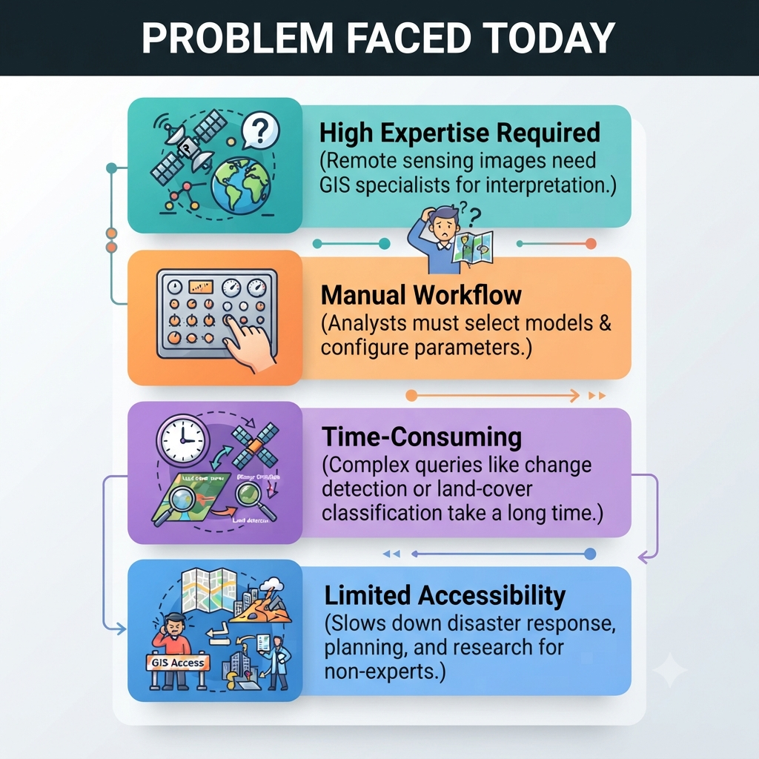
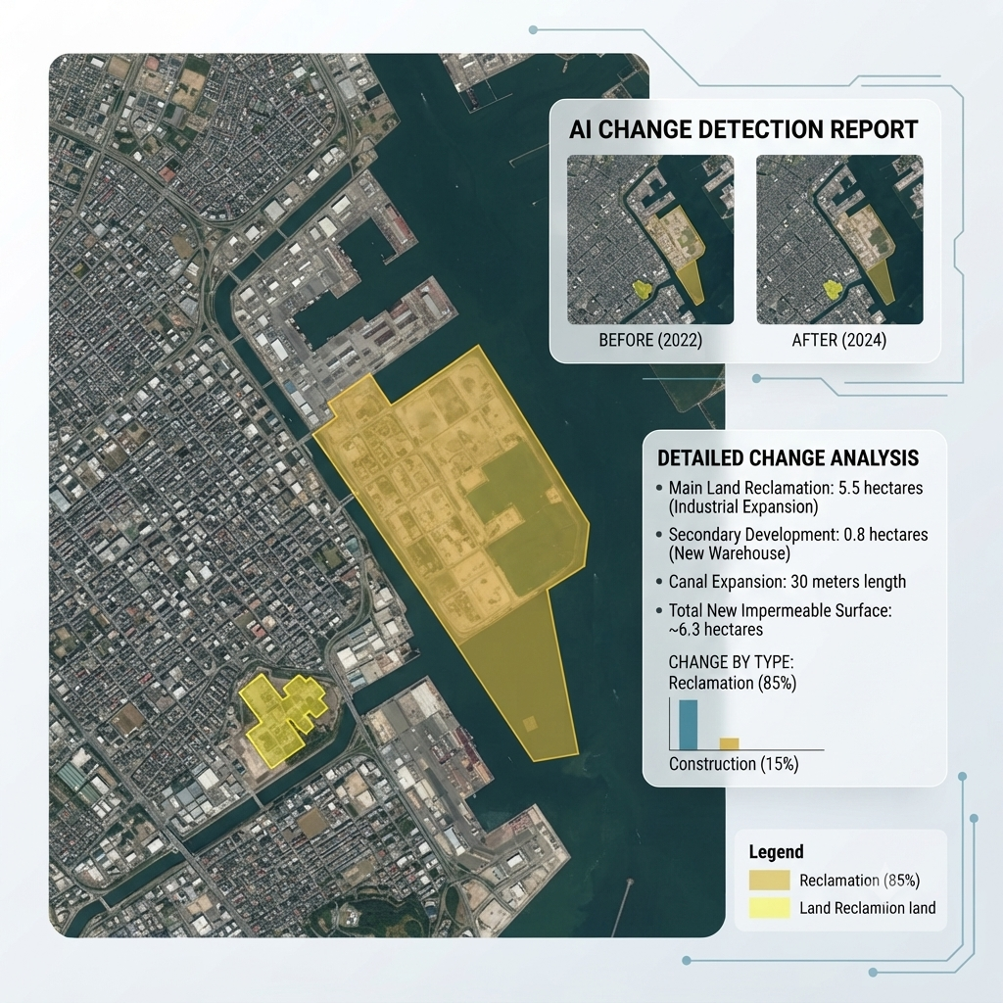
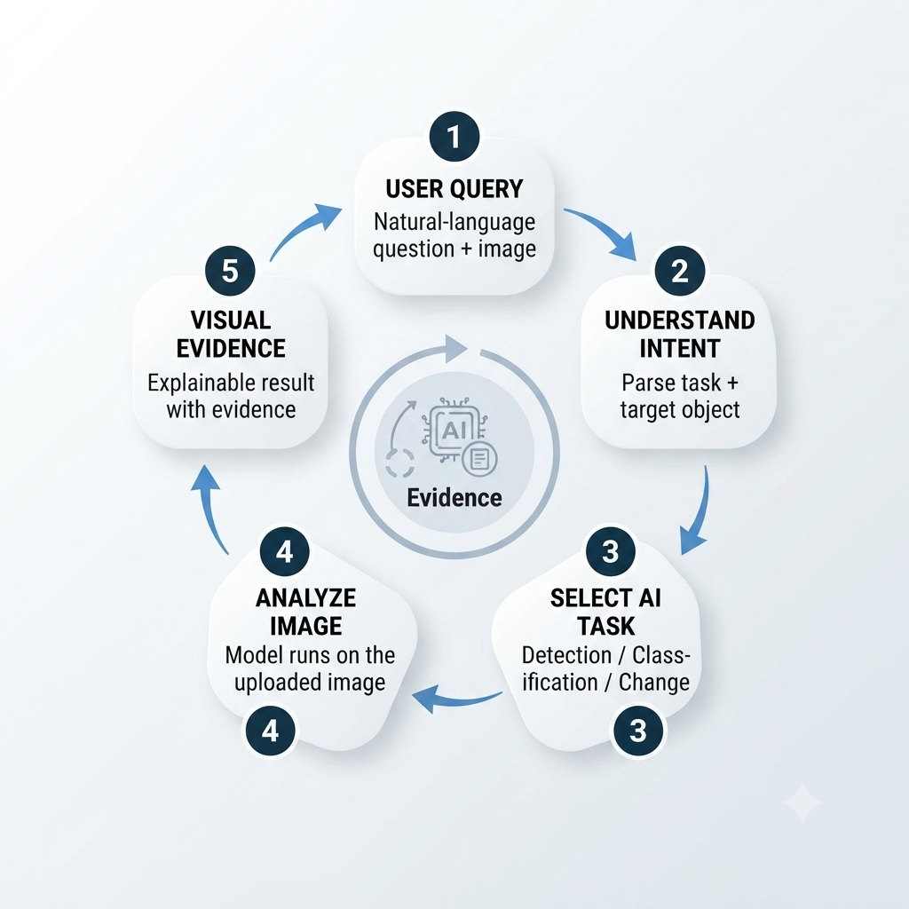
SatQuery AI - An Interactive Vision-Language Assistant for Multimodal Remote Sensing Image Analysis through Text Queries
Midnight
Syntax
Our Solution
  Natural language → AI routing (user asks, system selects the right model).
  Multimodal analysis (text + image context).
  Explainable outputs (bounding boxes, masks, confidence scores).
  Modular router → easy to add new tasks.
  Accessible interface → no GIS expertise required.
@SIH Idea submission- Template
2

Slide 3
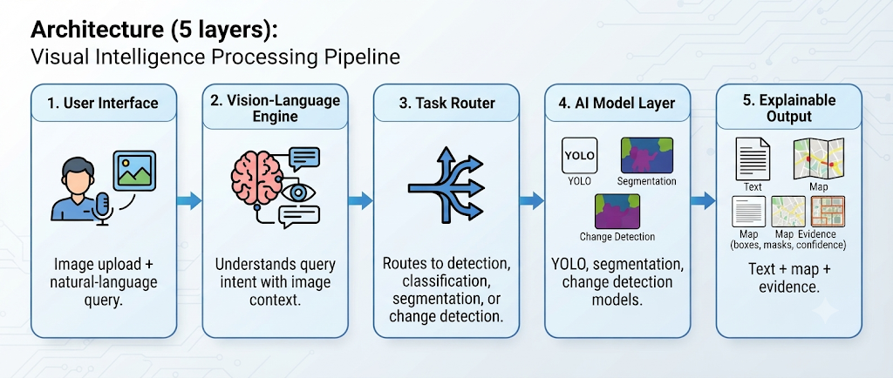
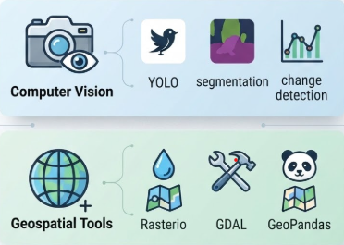
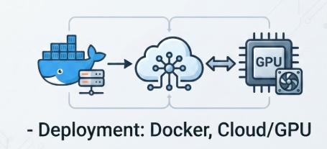
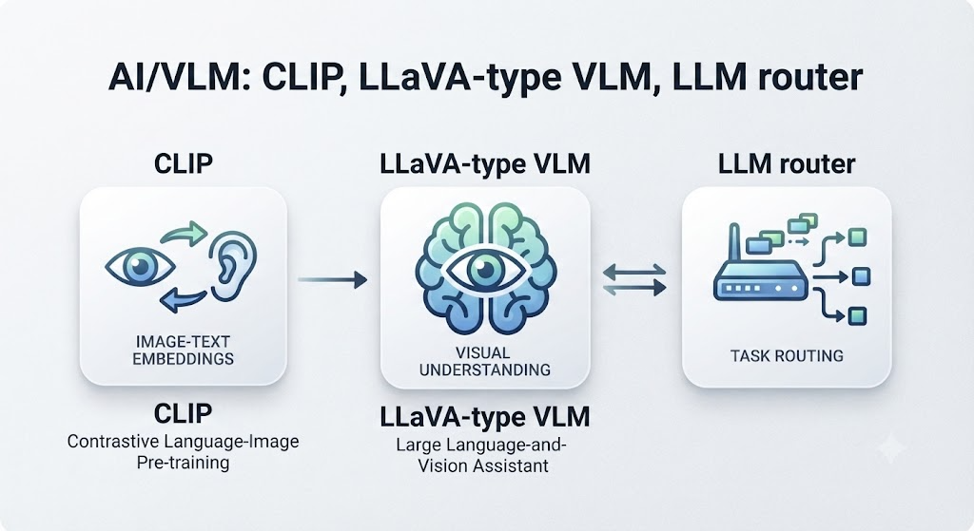


TECHNICAL APPROACH
Midnight
Syntax
Technology Stack:
  Frontend: React, HTML/CSS/JS
  Backend: Python (FastAPI/Flask)
  AI/VLM: CLIP, LLaVA-type VLM, LLM router
  Computer Vision: YOLO, segmentation, change detection models
  Geospatial Tools: Rasterio, GDAL, GeoPandas
  Deployment: Docker, Cloud/GPU
@SIH Idea submission- Template
3

Slide 4
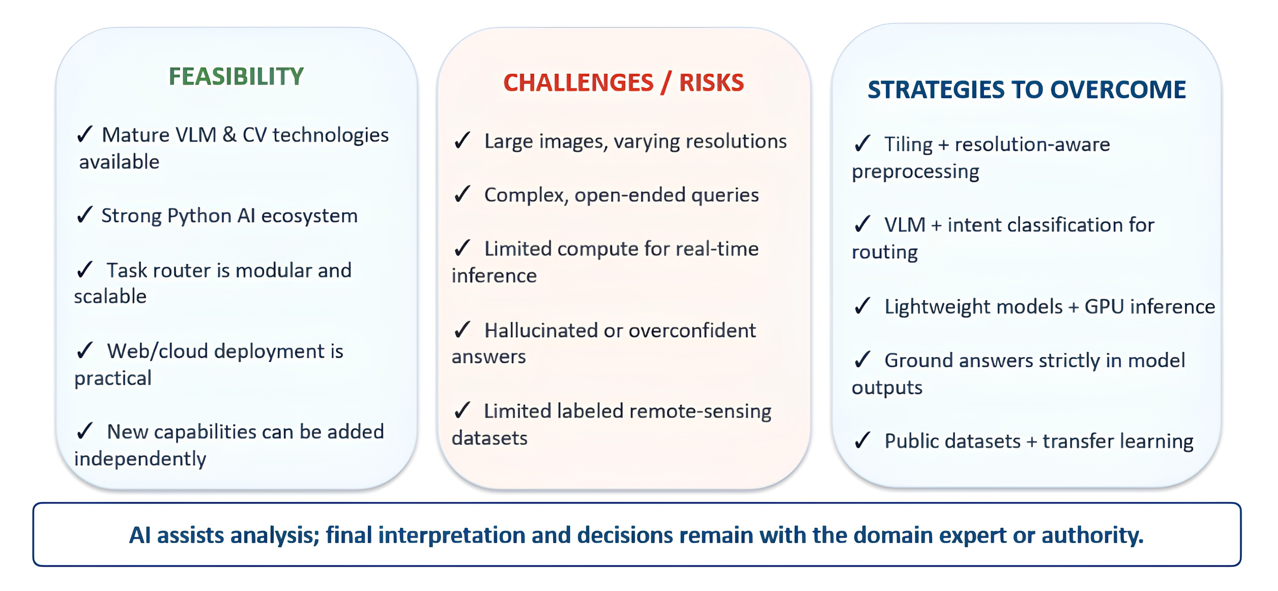
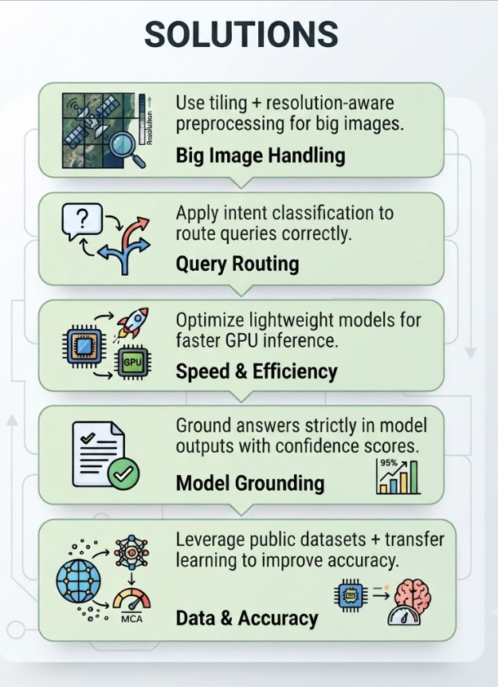
FEASIBILITY AND VIABILITY
Midnight
Syntax
@SIH Idea submission- Template
4

Slide 5
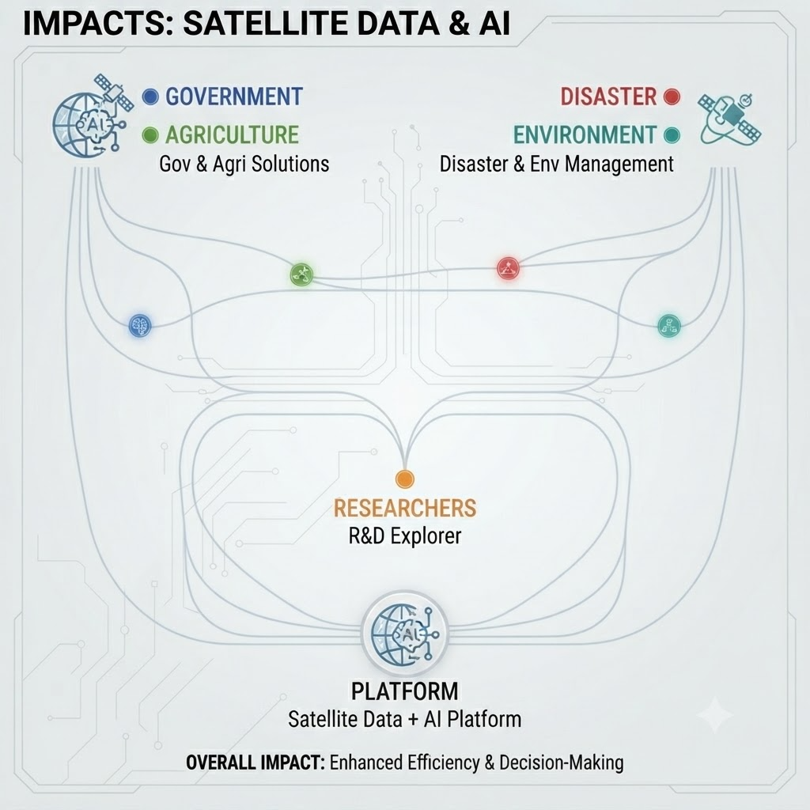
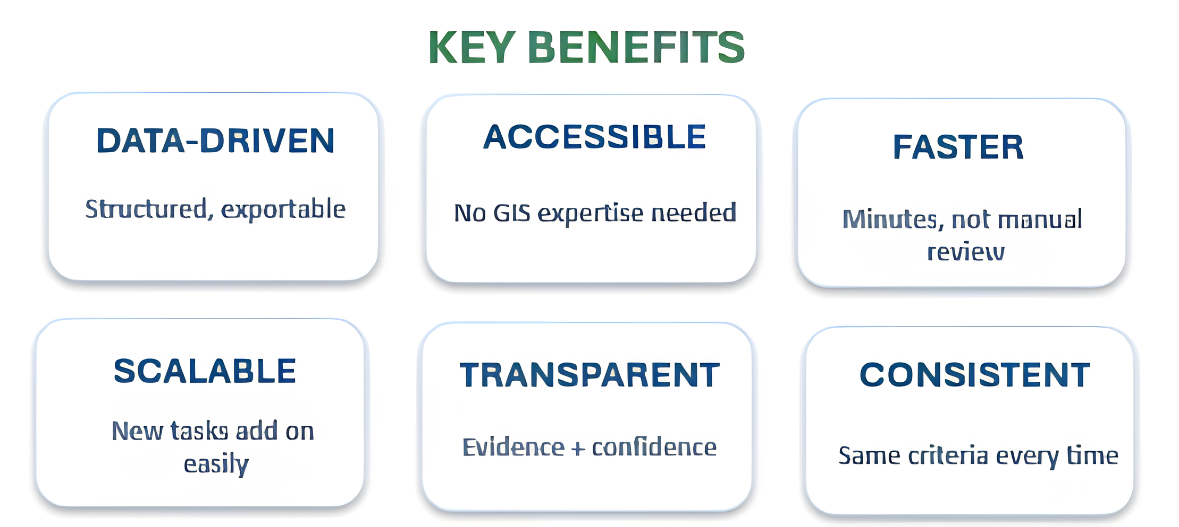
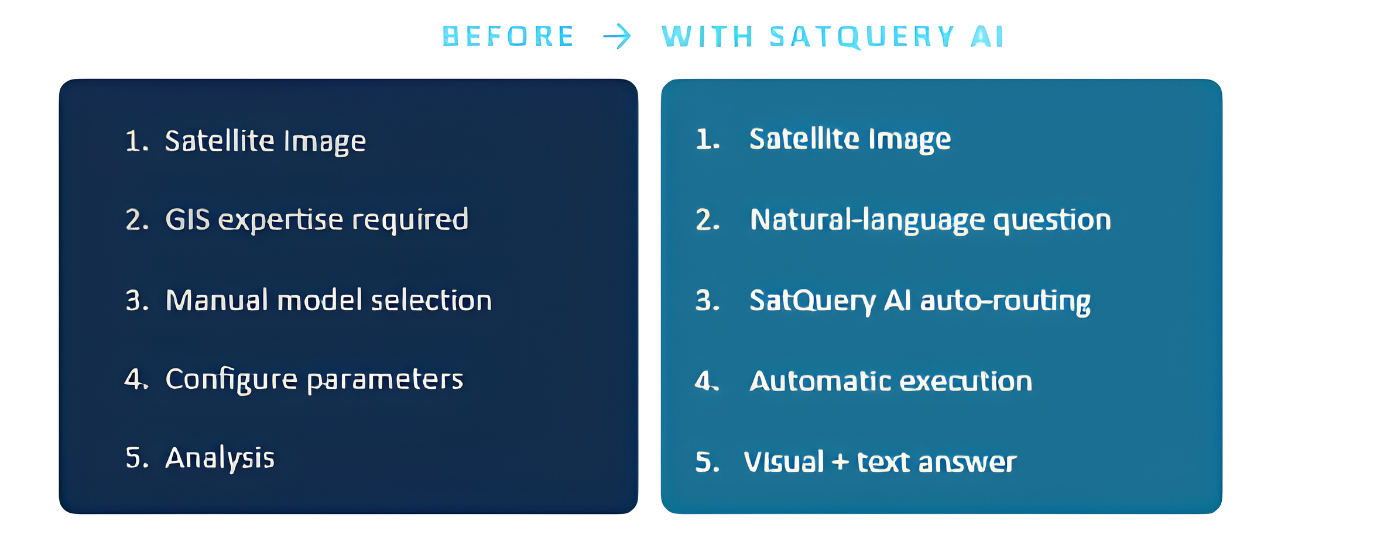
IMPACT AND BENEFITS
Midnight
Syntax
Impact
  Government: Disaster monitoring, infrastructure planning, urban expansion analysis.
  Agriculture: Crop monitoring, irrigation assessment, land-use classification.
  Disaster Management: Flood/fire detection, post-disaster change analysis.
  Environment: Forest cover, water-body monitoring, climate change tracking.
  Researchers: Faster exploration of satellite data with natural-language queries.
@SIH Idea submission- Template
5

Slide 6
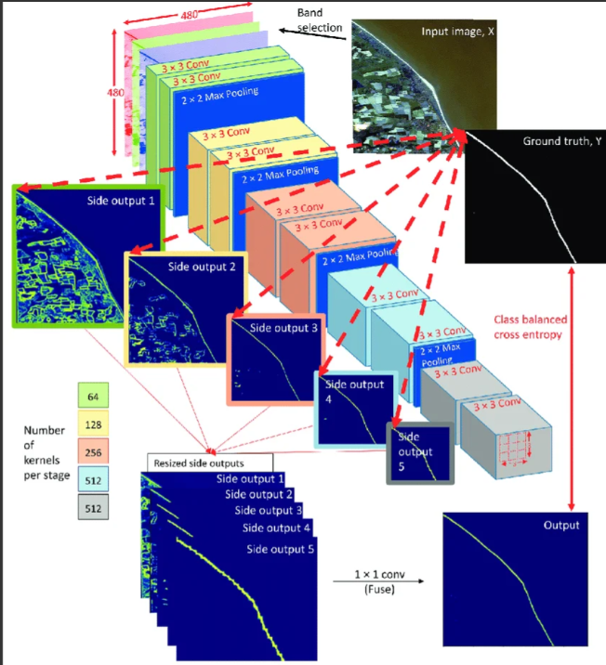
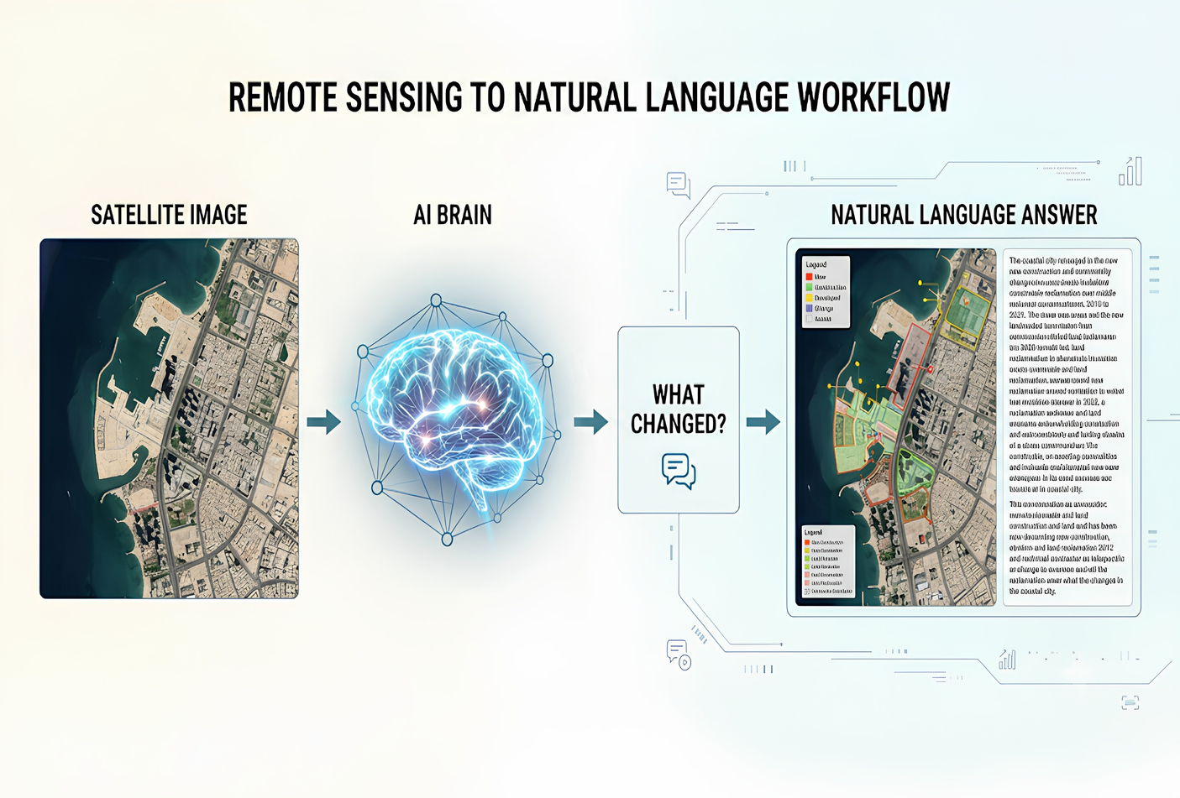
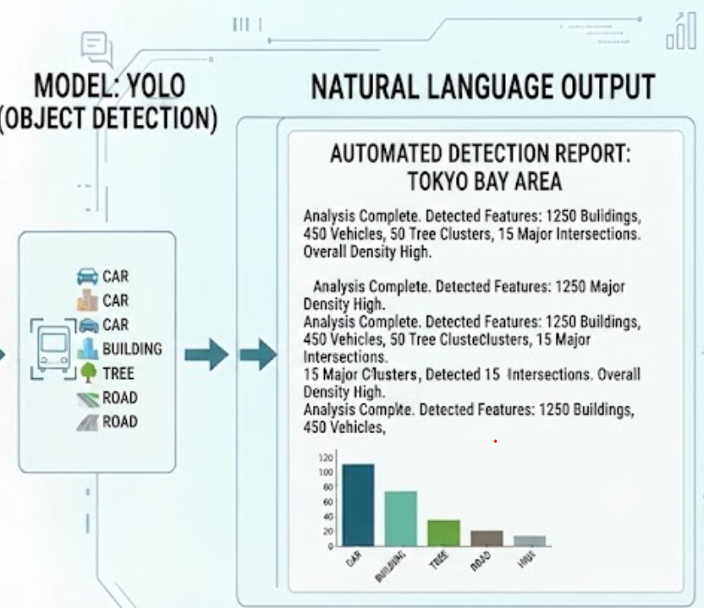
RESEARCH AND REFERENCES
Midnight
Syntax
RESEARCH
  Remote-Sensing Datasets: Copernicus Sentinel-2 (dataspace.copernicus.eu in Bing)
  Vision-Language Models: CLIP (arXiv)
  Remote-Sensing VLM Research: arXiv 2311.15826
  Object Detection Models: YOLO Documentation
  Change Detection Research: Springer AI Review (link.springer.com in Bing)
  Geospatial Tools: GDAL
@SIH Idea submission- Template
6

